Slide 1

Sports scores and statistics web app
Student: RAHMAN MD MOSTAFIZUR
SID NUM:2017002114
Supervised BY TEACHER
ZHU SHAOJUN

Slide 2
The presentation is a part of my 3rd Year Project for the degree of BSc. in Computer Science and technology in the School of information engineering HUZHOU UNIVERSITY, CHINA.
My application shows basic information about the different competitions, teams and players. It also shows previous and future games, as well as the league table at the moment for each competition. The additional information I did was to create a next round league table which shows how the league can change in the next round and how much each team can rise or fall in that round, considering the games to be played. I will launch it international as soon as possible. People will able to see live scores, fixtures ,team news, blogs , live games.

Slide 3
TECHNOLOY USES :
FRONT END:
1. Html 5
2. CSS 3
3.Bootstrap 4
4. JavaScript
5. JQuery

Slide 4
Back end:
1. Node.js
2. Express.js
3. API
4. MongoDB
5. Mongoose

Slide 5
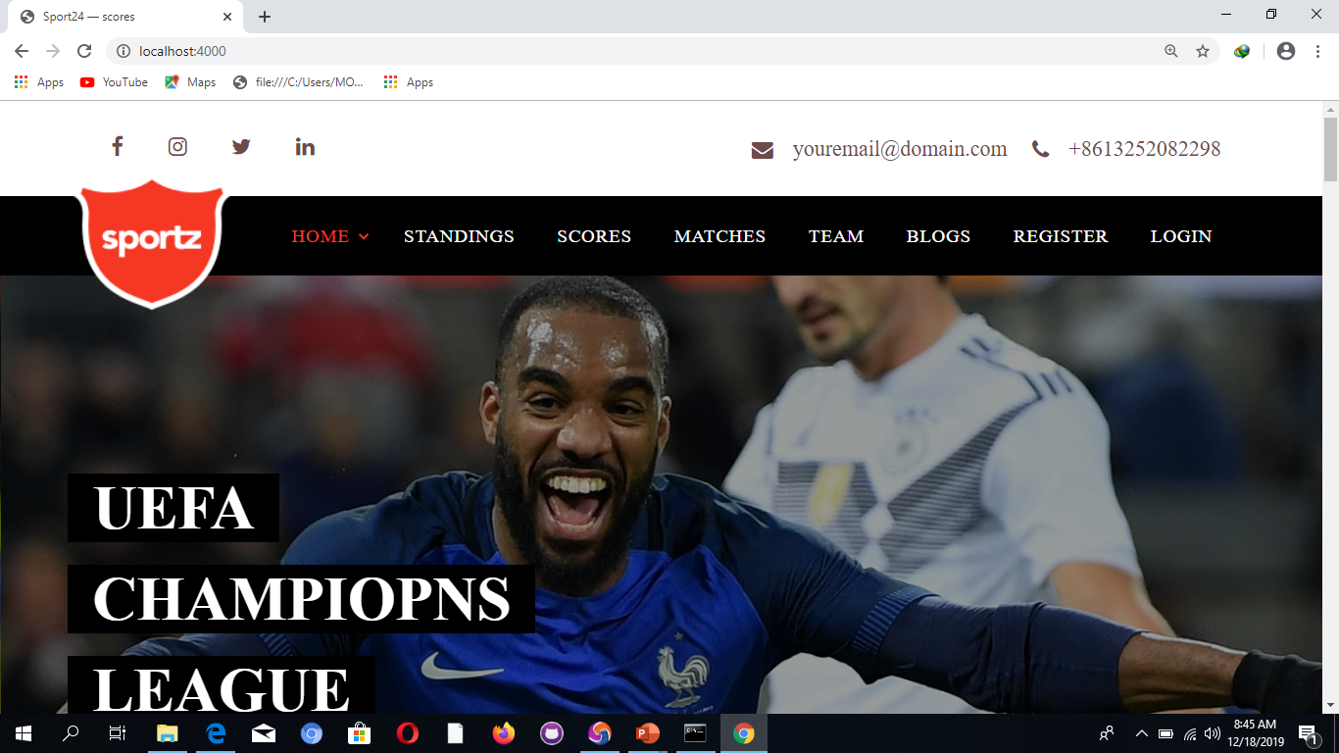
DEMO OF HOME PAGE:

Slide 6
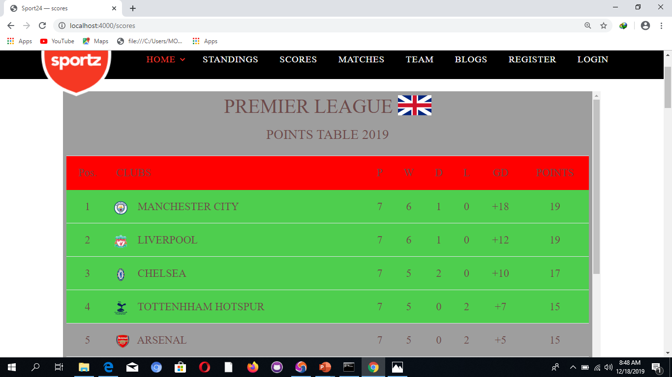
POINT TABLE PAGE:

Slide 7
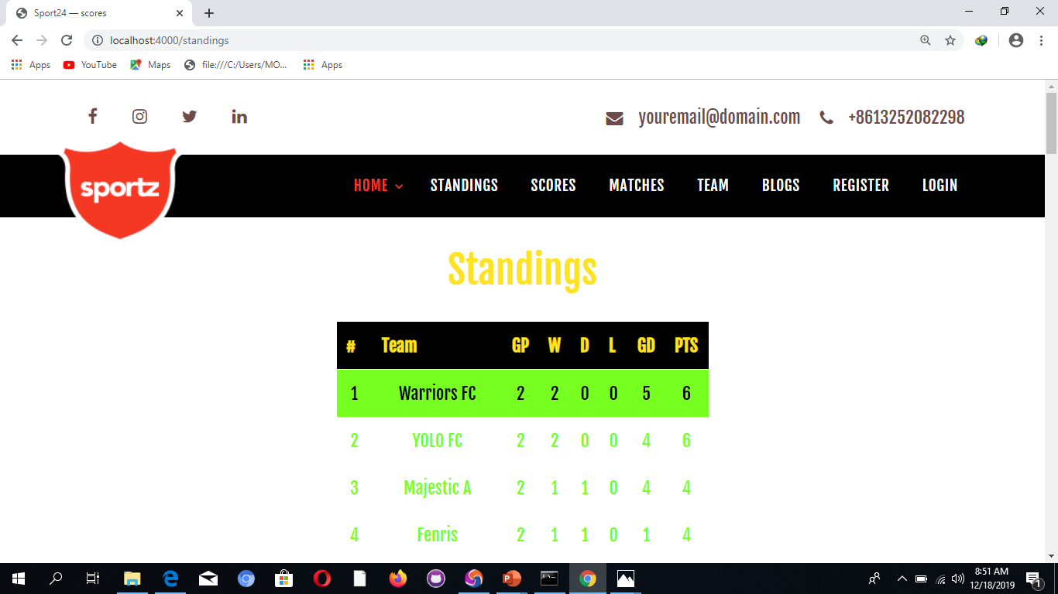
STANDINGS PAGE:

Slide 8
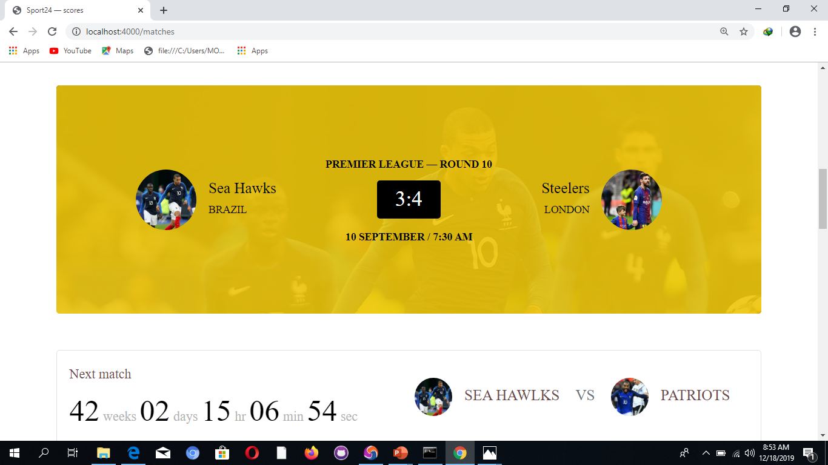
MATCHES PAGE:

Slide 9
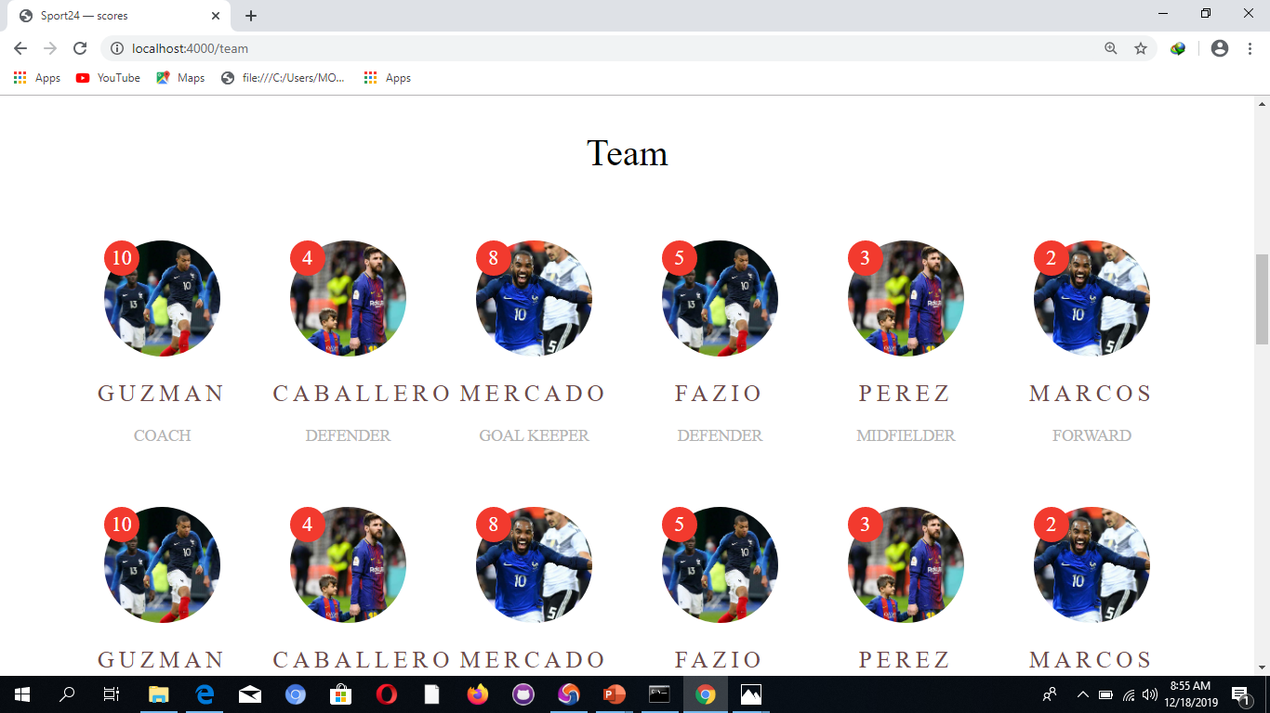
TEAM PAGE:

Slide 10
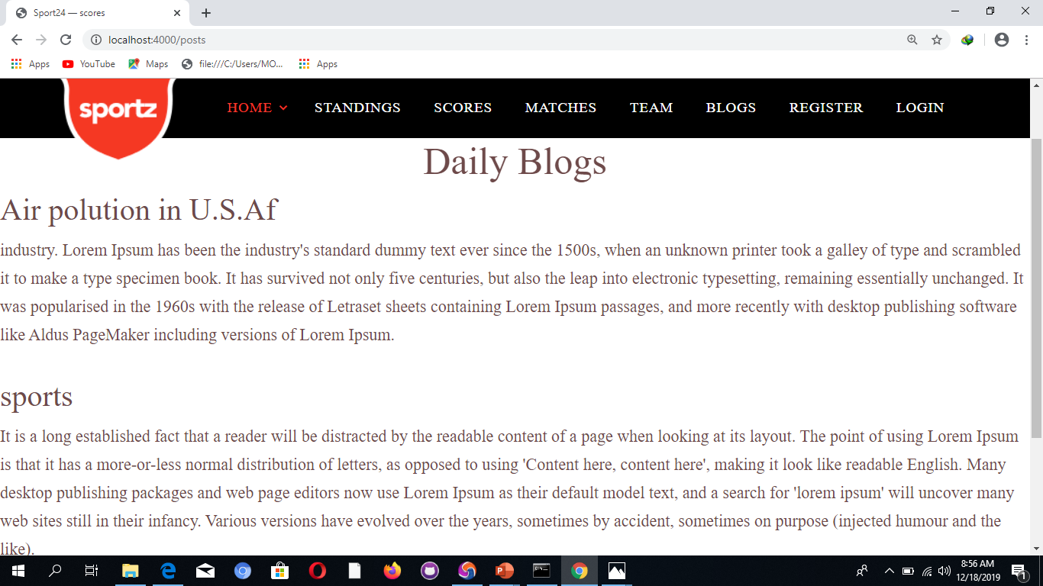
BLOG PAGE:

Slide 11
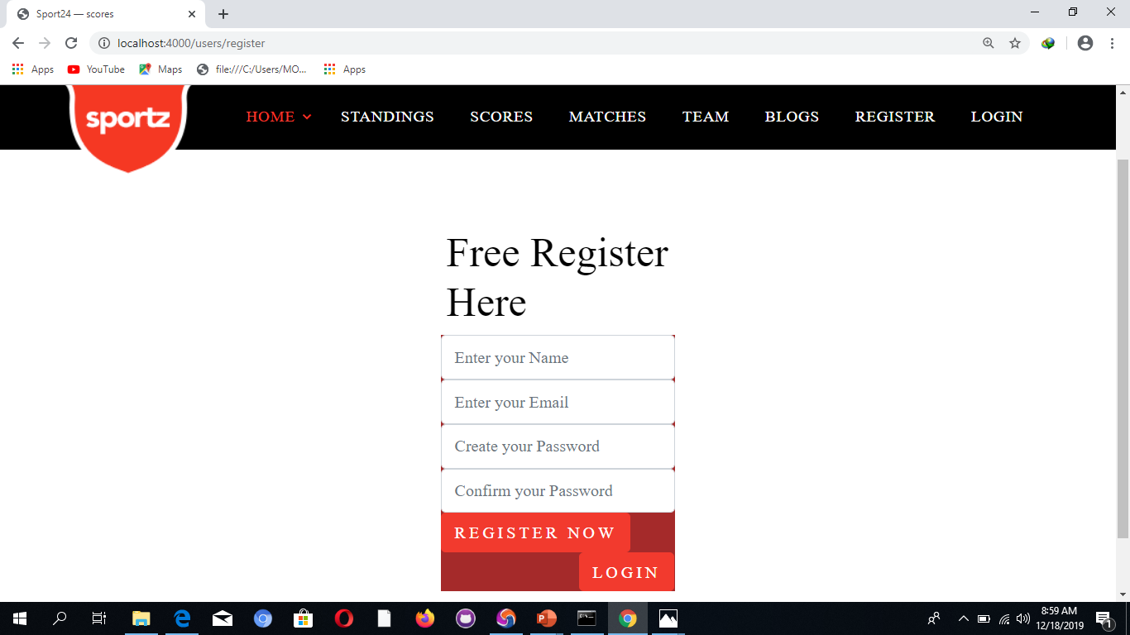
REGISTER PAGE:

Slide 12
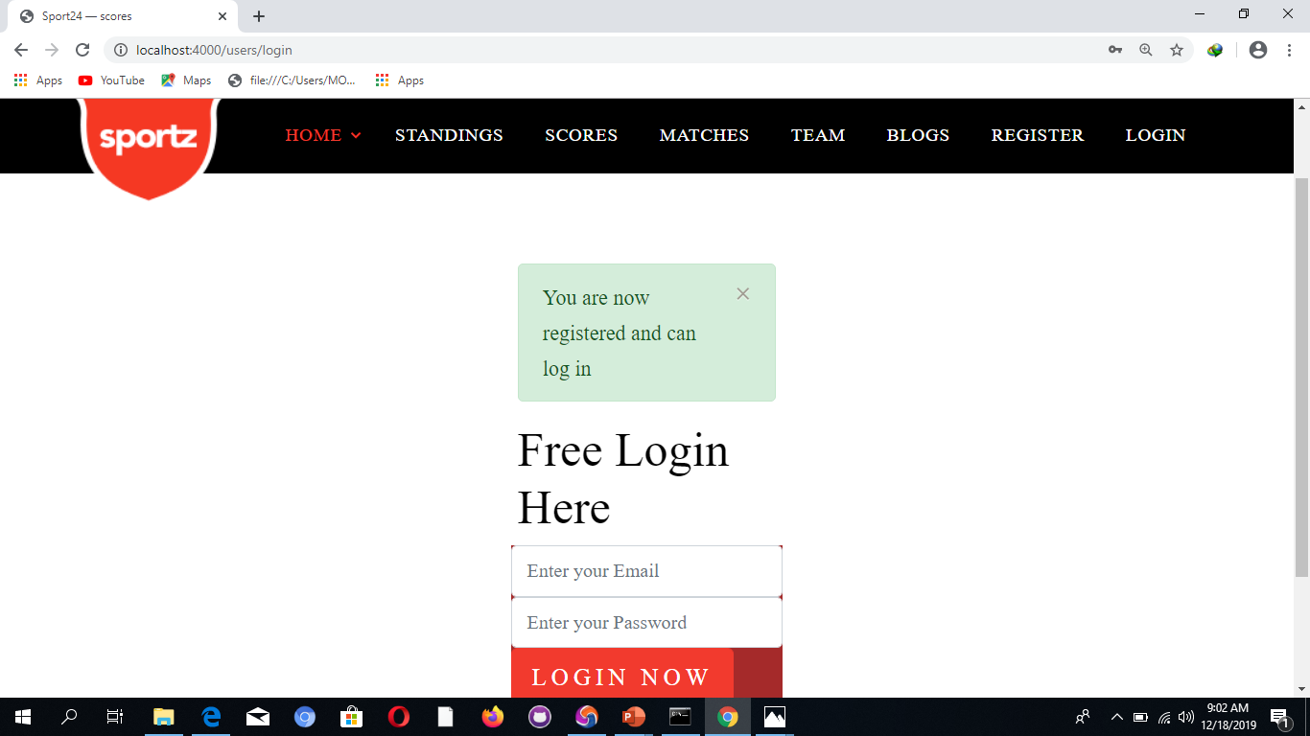
SUCCESSFUL REGISTRATION MASSEGE:

Slide 13
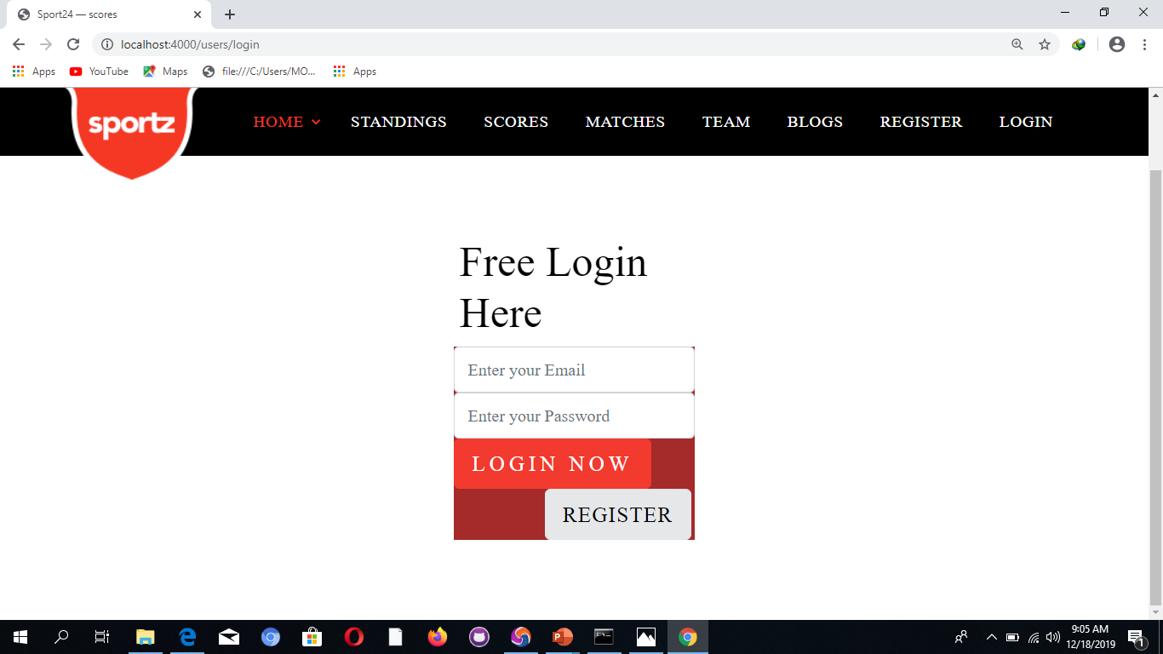
LOGIN PAGE:

Slide 14
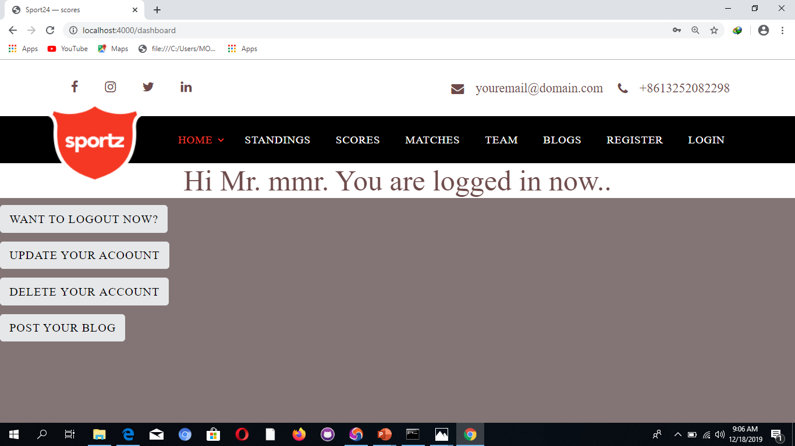
SUCCESSFUL LOGIN:

Slide 15
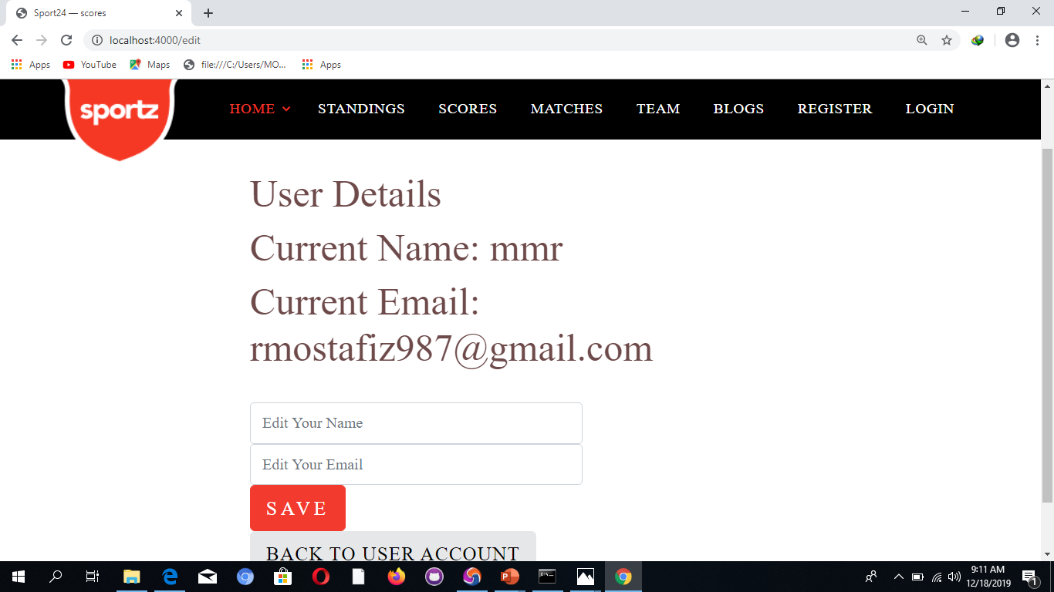
UPDATE INFORMATION:

Slide 16
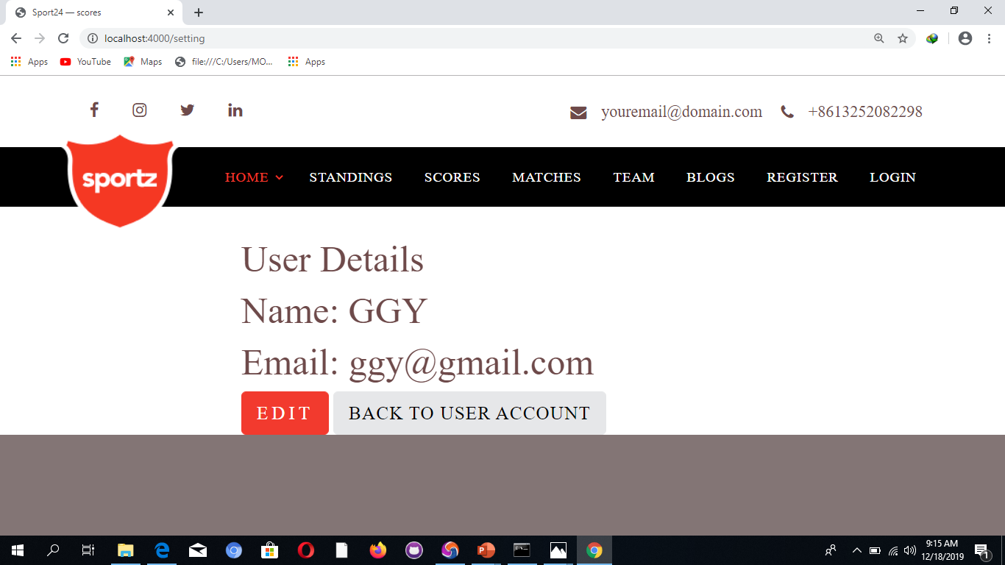
UPDATE SUCCSSS:

Slide 17
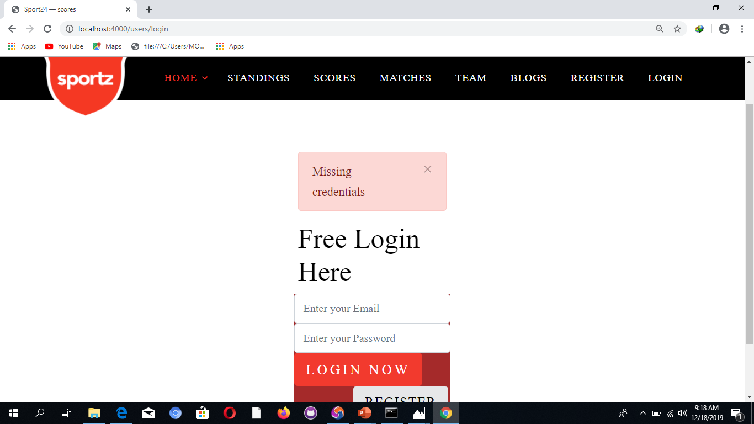
DELETE ACCOUNT:

Slide 18
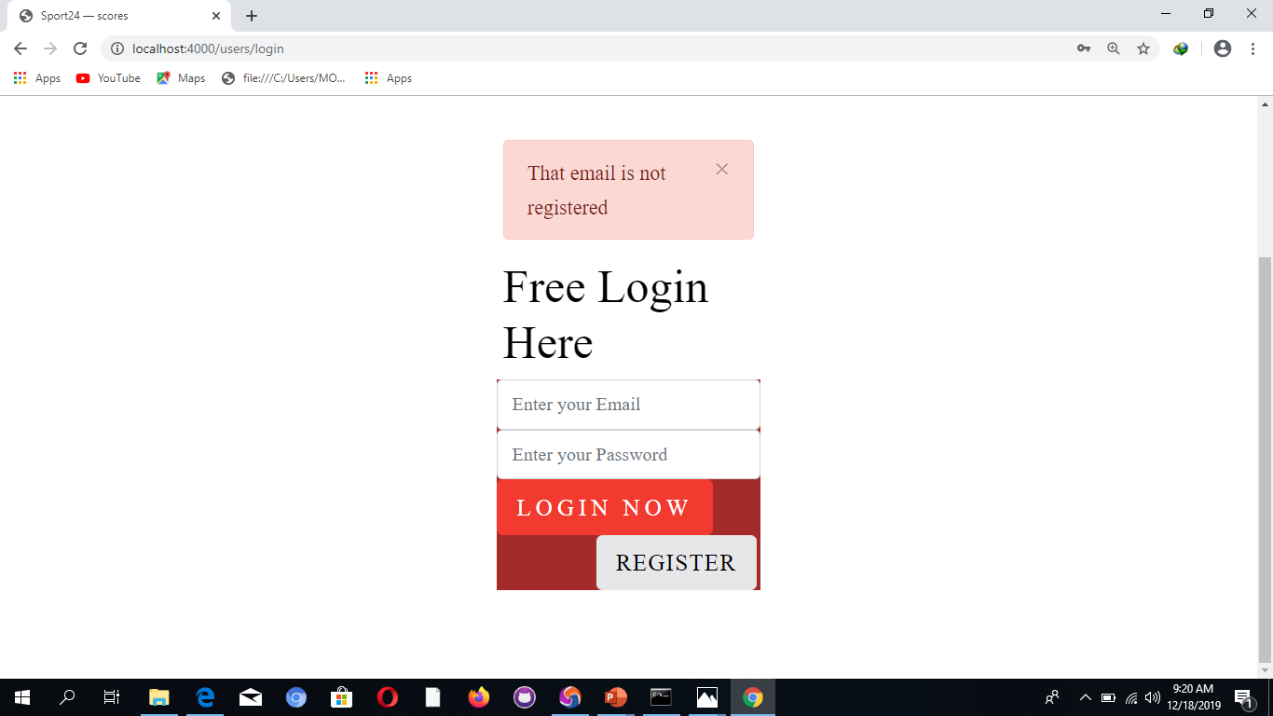
DELETE:

Slide 19
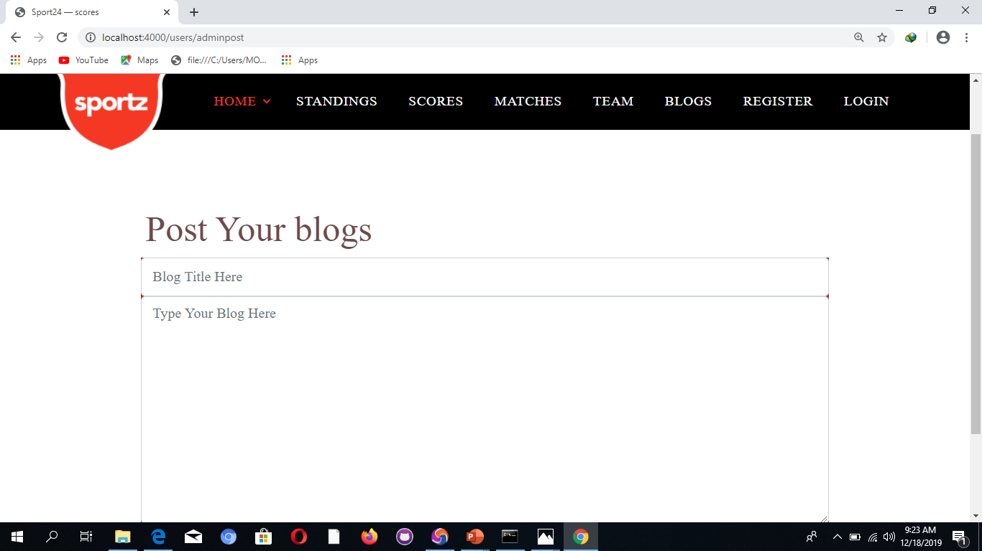
BLOG POSTING:

Slide 20
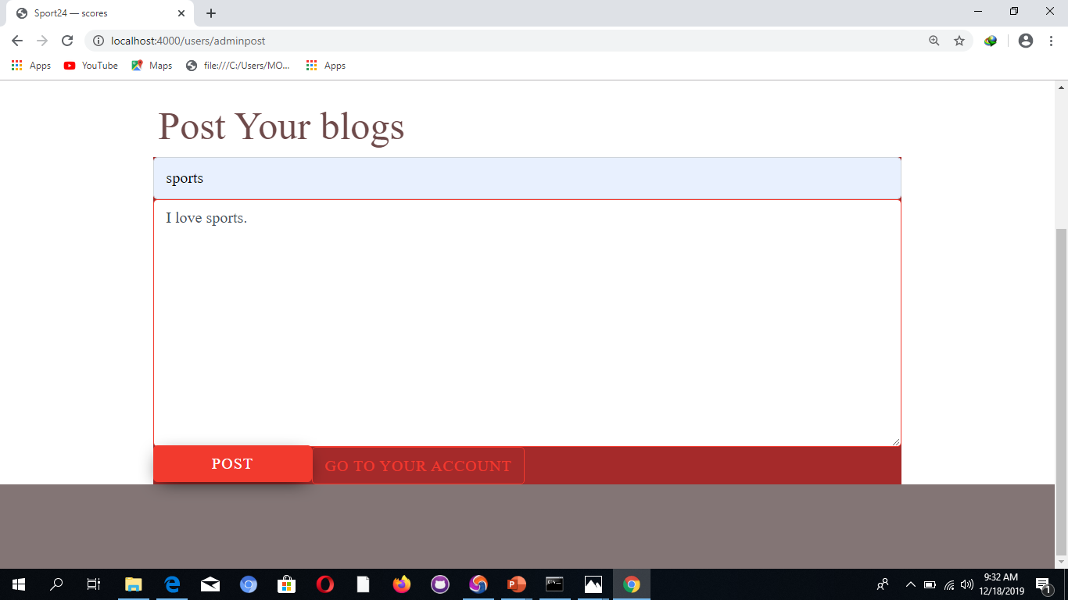
BLOG:

Slide 21
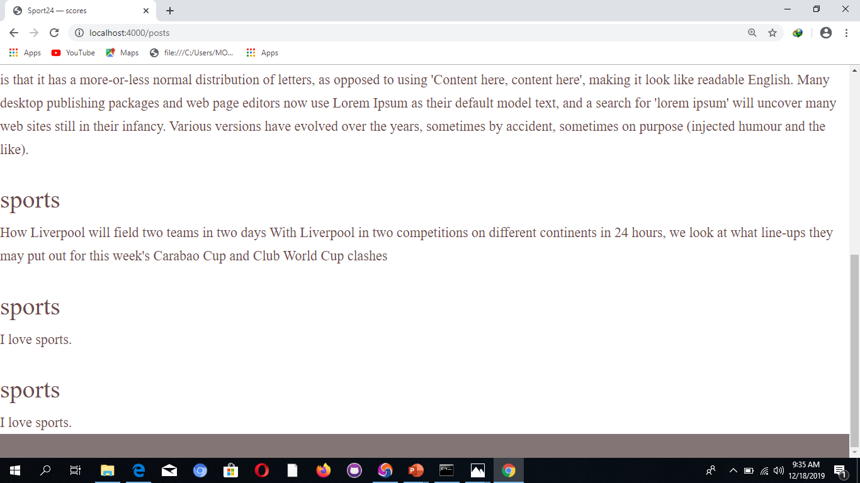
SUCCESSFUL POST:

